Slide 1

“With guys like me and Iggy, only a fraction of the stories you’ve heard are true. With Jack, every story is true, and you’ve only heard a fraction of them.” Anonymous Rock Legend
BODY & SEOUL
A TV SERIES SET IN SEOUL KOREA
1
1

Slide 2
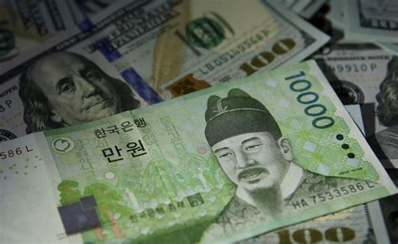
About “Body & Seoul”
A brilliant visionary music producer whose "best years" look to be behind him discovers the brilliance of download to own music and leaves the doubters, glamor, and excess of Los Angeles only to be thrown into a paradigm shift moment in the music industry taking place in South Korea. With his new boss and collaborator, Kelly Lim, they navigate a world of fame, fortune, love and organized crime to keep the label alive, but Jack's drive and obsession may cause everything to collapse and burn.
BODY & SEOUL is a scripted global Action True Crime series based on true events.
Michael Mandaville (Taken 1, 2, 3) Show Runner. (60 min x 8-10 Episodes
SETTINGS: 1999/2000 Los Angeles, 2000 - ? Seoul Korea.
GENRE: International Crime / Music / Korean Culture
TONE: Music Industry / Organized Crime / Seoul Korea glamour

Slide 3
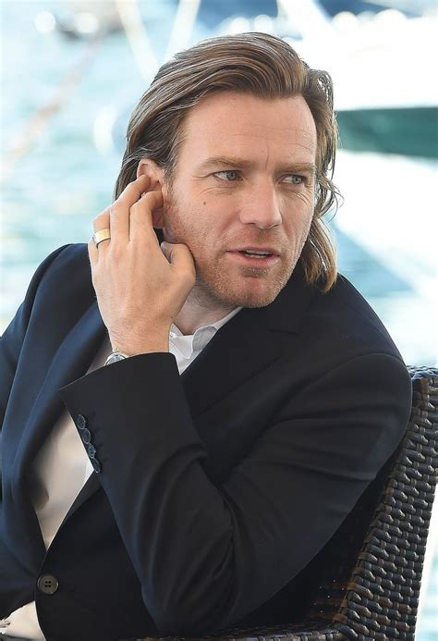
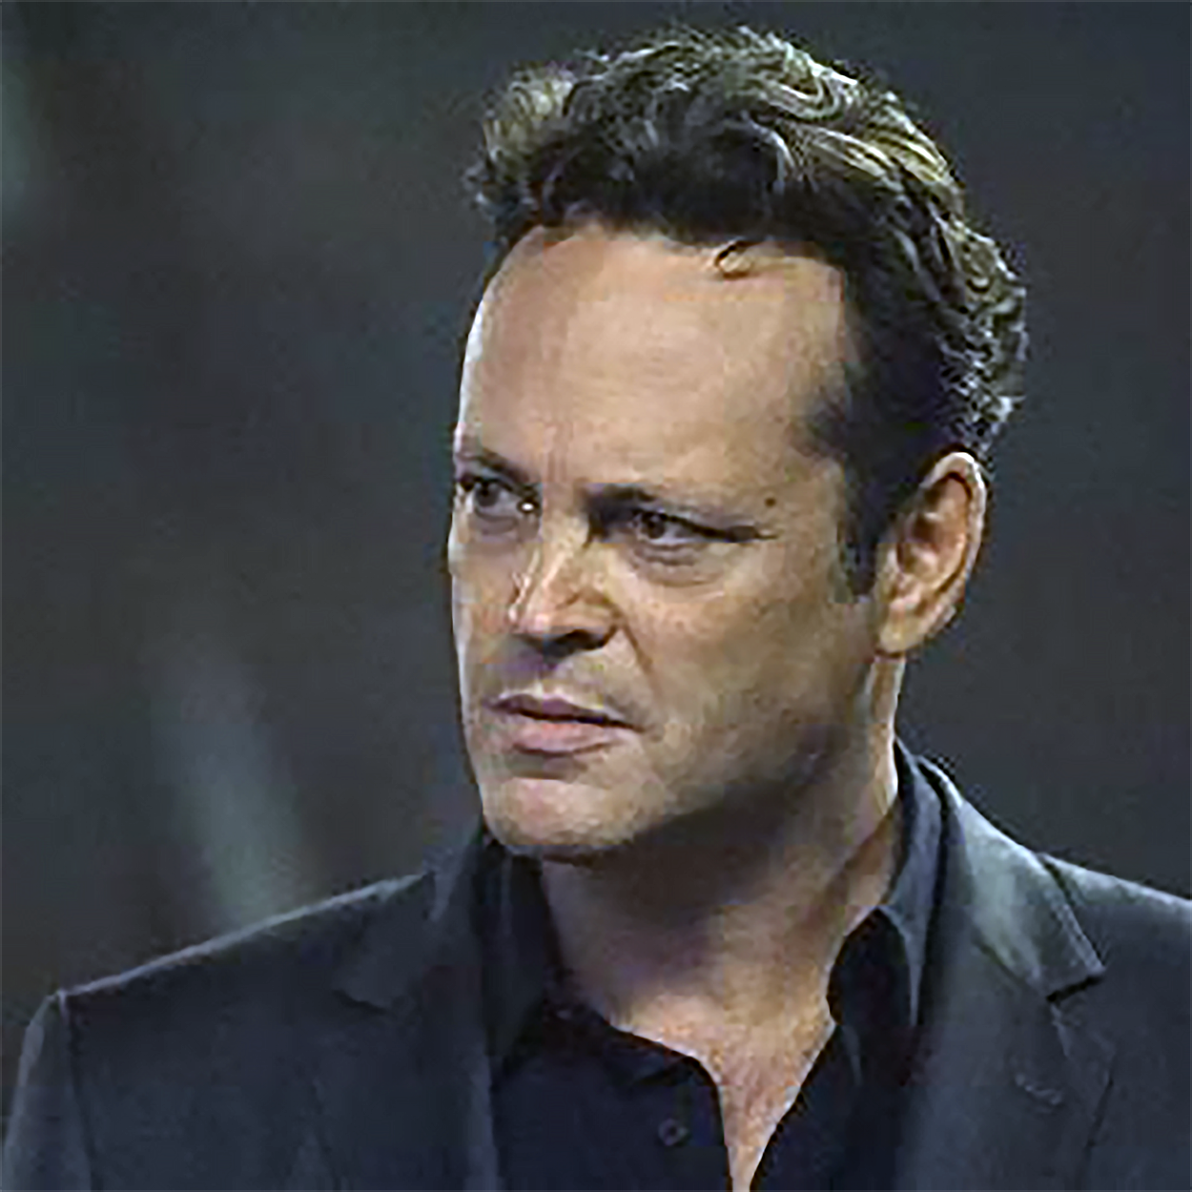
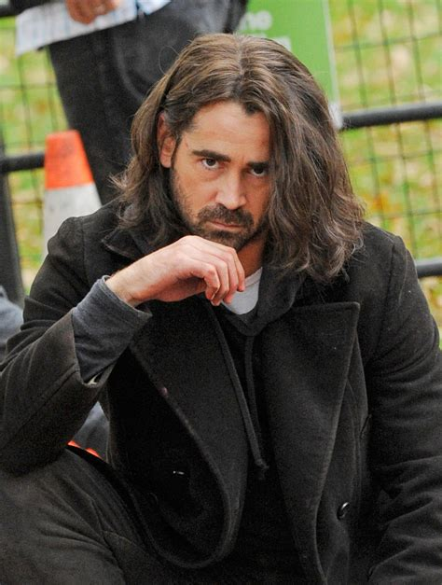
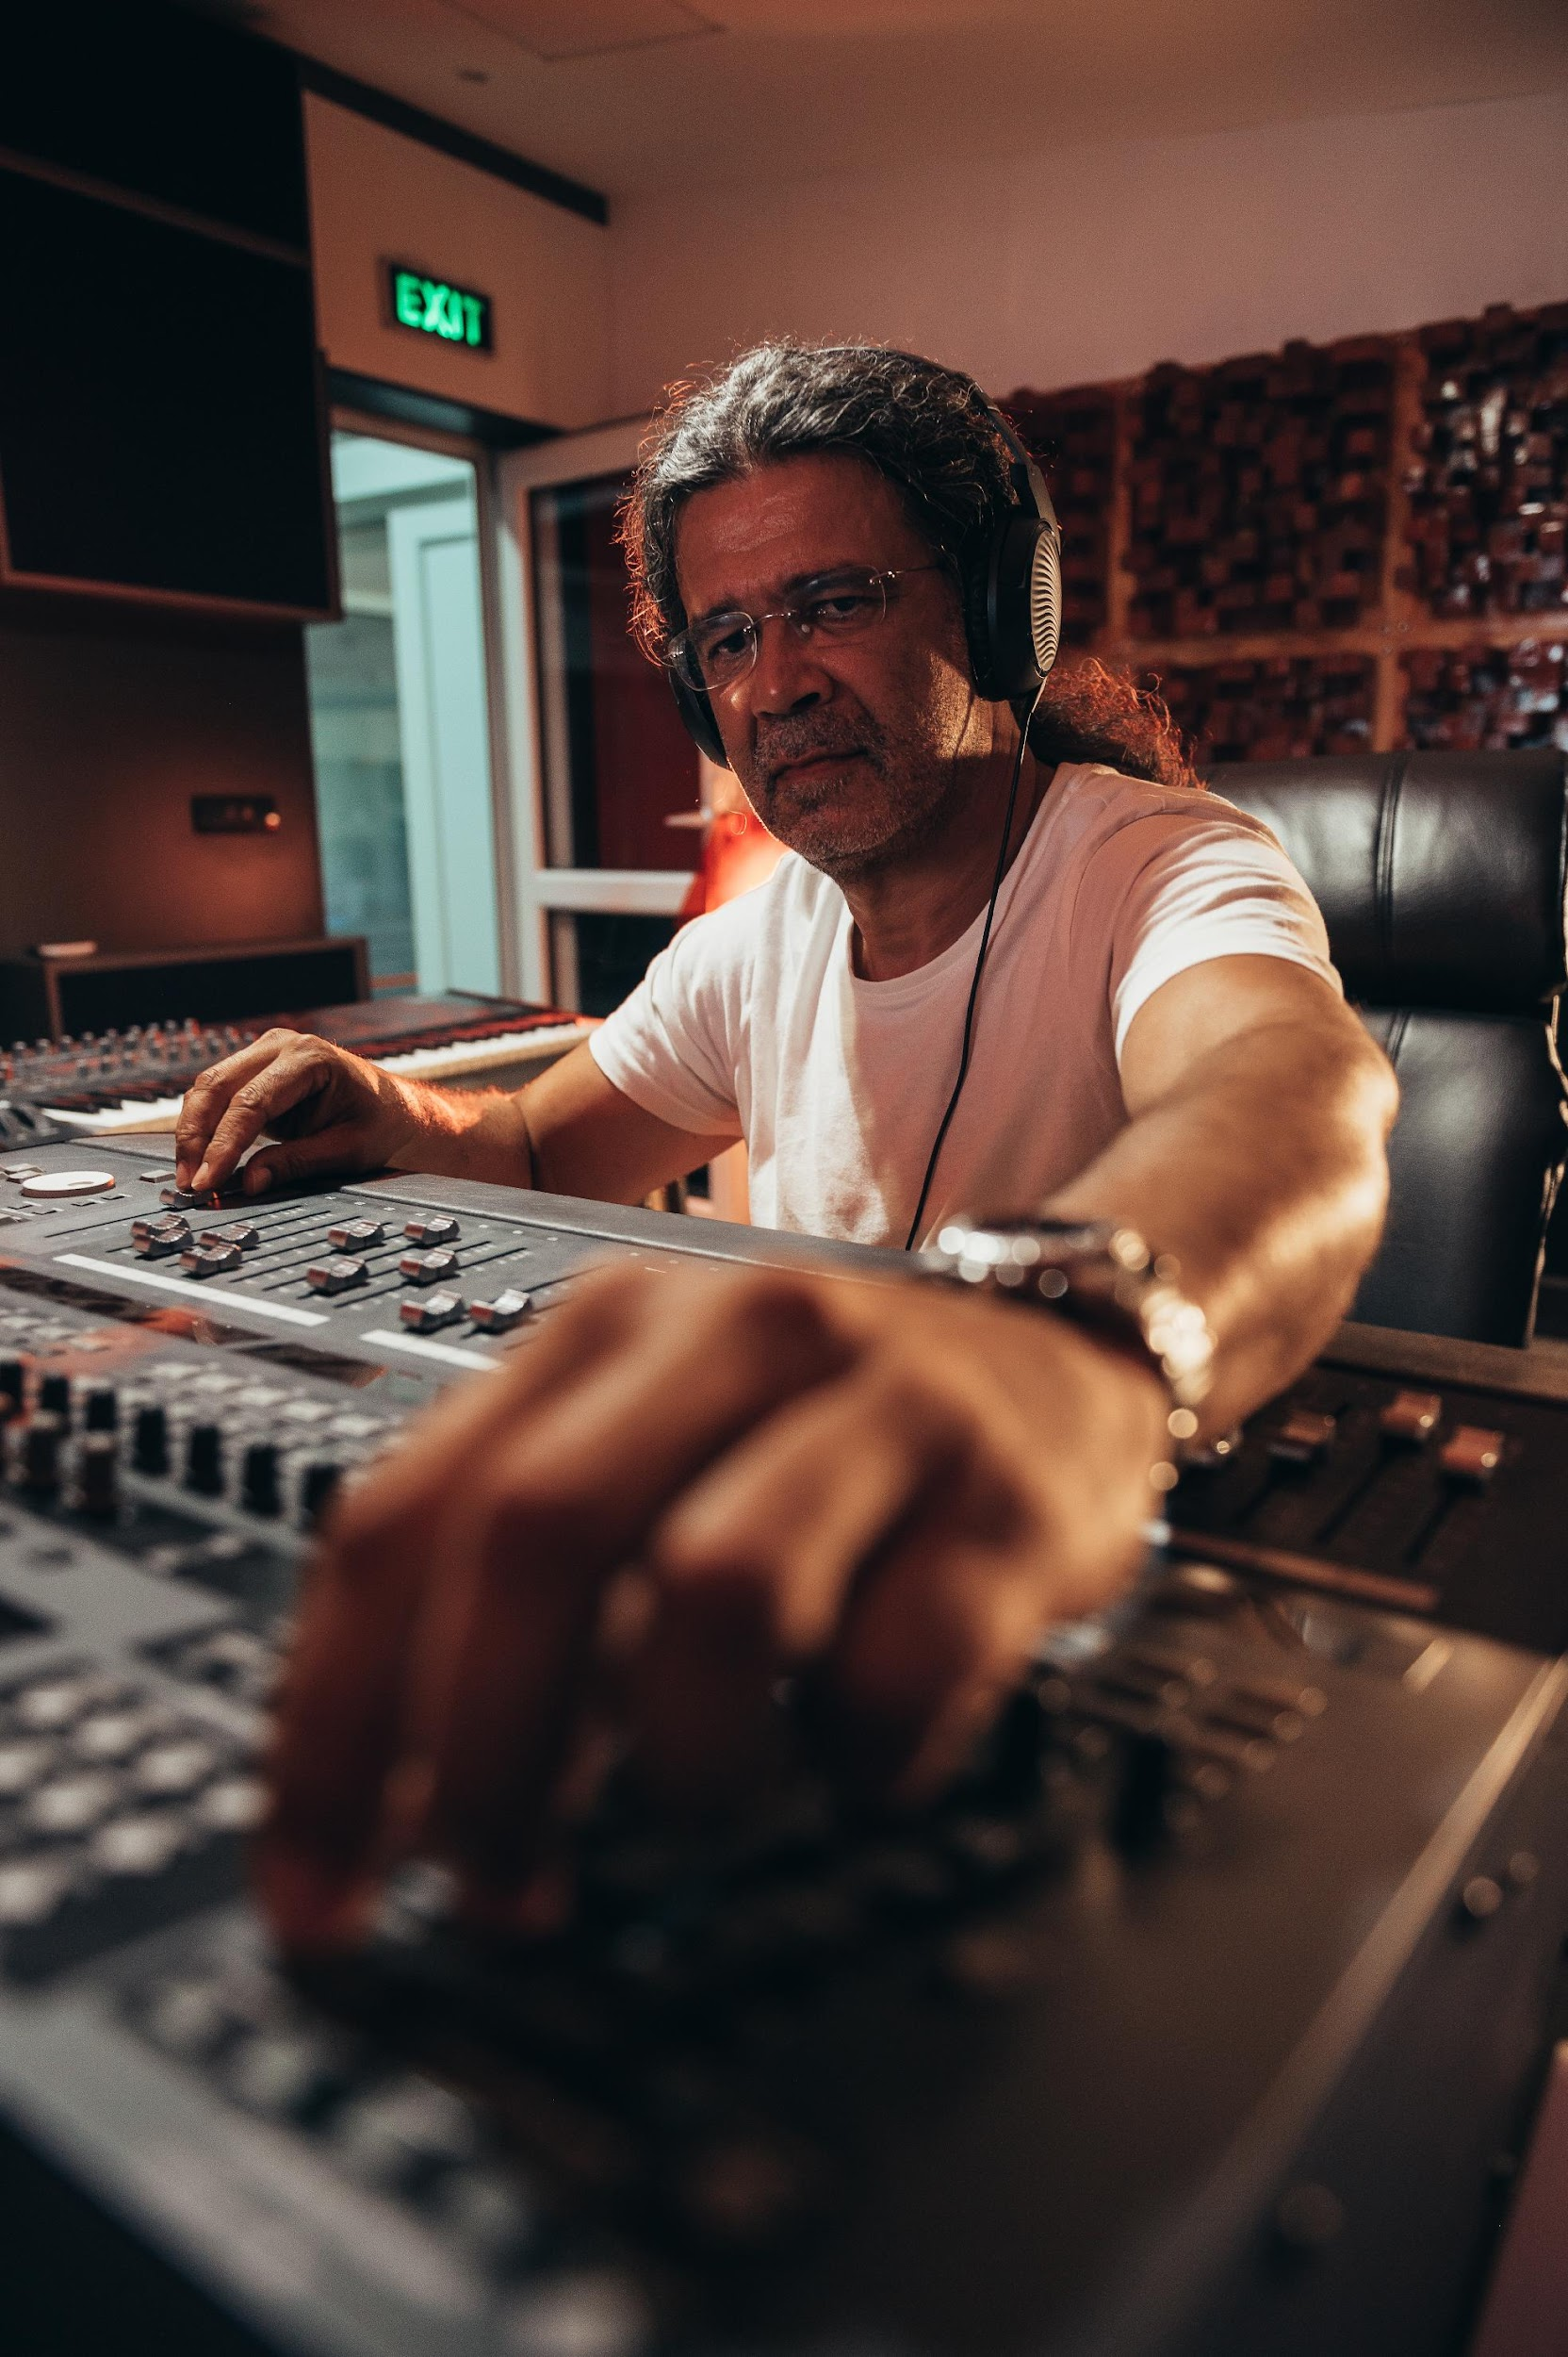
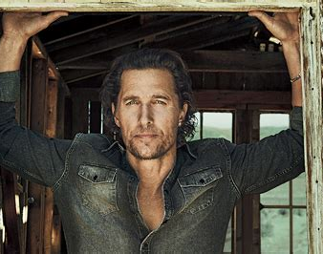
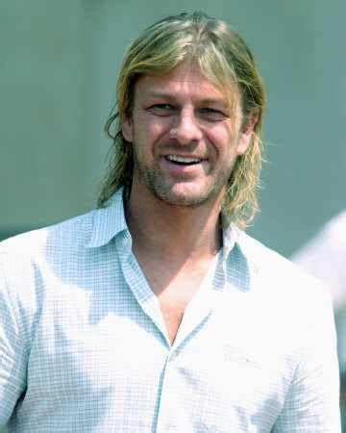
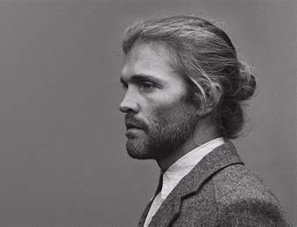
Type of Talent
Jack Smith – He is equal parts fashion and swagger, Jay Z-like business acumen and the excess of Steven Tyler. And he’s known as Hollywood’s
best music producer. Bright, daring and impetuous, he maneuvers through the world of business, musician ego and the artistic world. His vision of a digital music world is his obsession.
(Actors Types: Vince Vaughn, Ewan McGregor, Colin Farrell)

Slide 4
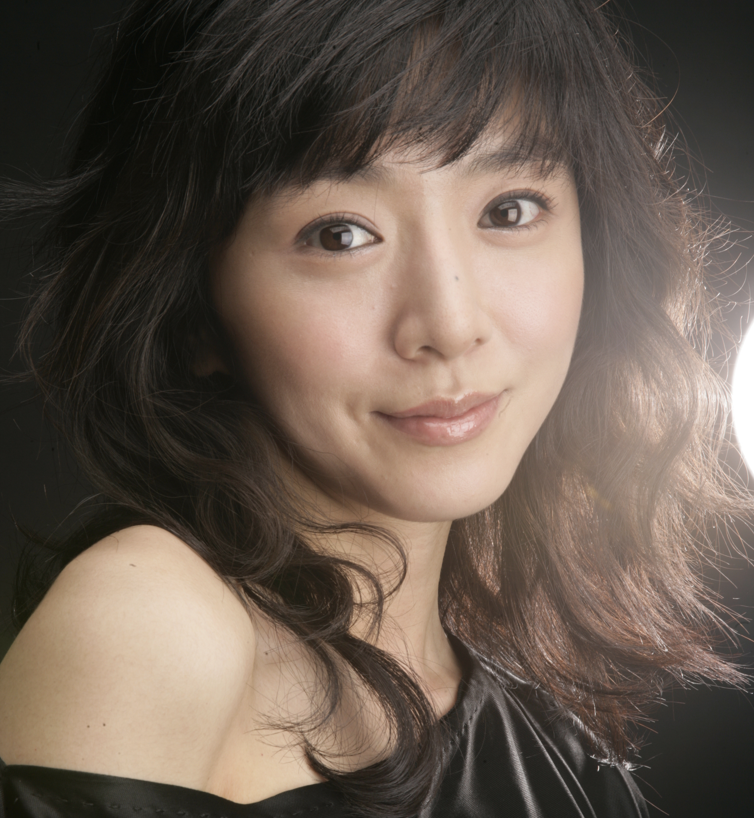

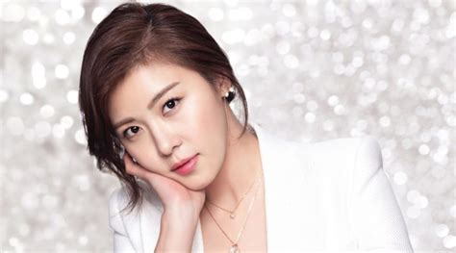
Type of Talent
Kelly Lim - She is navigating through the music business in South Korea, protecting her aging father and her family’s livelihood. Real tough, industrious, resourceful and ambitious. She will become an icon in the industry.

Slide 5
Body & Seoul
Award Winning Korean Talent
The series has significant Korean Talent interest through the deep personal relationship of two Executive Producers, AJ and Robert Lennon. These producers and Michael Mandaville met with key Korean talent during a visit to South Korea.
The Korean talent is award-winning, nationally acclaimed, and at the top of their artistic game.

Slide 6
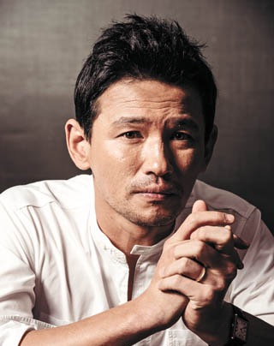
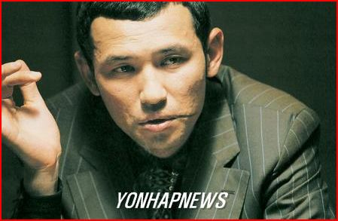
Gangster Tiger
Hwang, Jung-min (황정민) Korea’s Academy Award-winning TV and Film Star and Top Three Most Viewed Actor has shown sincere interest to play Gangster Tiger (호랭이파).
Gangster Tiger - Both intimidating and infuriating, he has absolute control over the world he considers his own kingdom. He is the "Dapper Don" of the criminal underground and his special charm demeanor can sway those who don't "know" him.
Top Movies
Narco – Saints (Netflix Series) as Pastor Jeon Yo-hwan (2022)
Deliver Us From Evil | (2020) - In-Nam
The Spy Gone North | (2018) - Park Suk-Young
The Battleship Island | (2017) - Lee Kang-Ok
Veteran (2015) - Detective Seo Do-Cheol
Ode to My Father| (2014) - Yoon Deok-Soo
New World | Sinsegye (2013) - Jung Chung
Awards:
Best Actor ("The Spy Gone North") - 2018 (39th) Blue Dragon Film Awards - 2018
Best Actor ("The Spy Gone North") - 2018 (55th) Daejong Film Awards - 2018
Best Actor ("Ode To My Father") - 2015 (52nd) Daejong Film Awards - 2015
Best Actor ("New World") - 2013 (34th) Blue Dragon Film Awards - 2013
Best Actor ("The Unjust") - 2011 (15th) Fantasia Film Festival - 2011

Slide 7
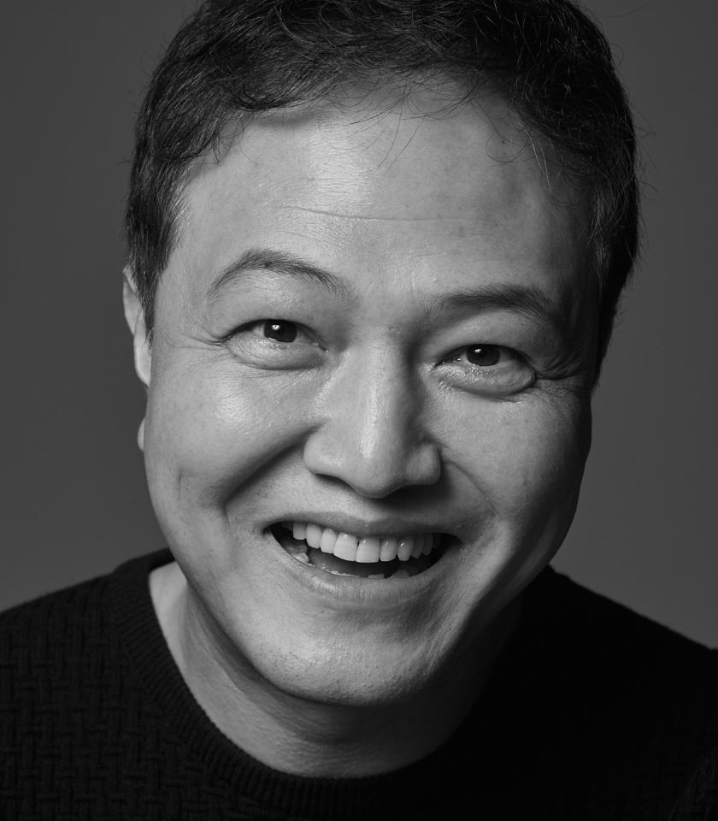
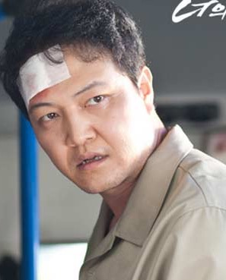
Detective Chong
Jeong, Woong-in (정응인) Korea’s Emmy Award-winning TV and Film Star, will play Detective Chong
70+ starring and co-starring credits
Detective Chong- He is good guy in a tough job, but not afraid to get dirty to achieve justice. He wants to break the back of the Korean mafia in the music industry.
Top Movies & Series
Seoul Vibe | (2022) - Chief Prosecutor Woong-In
The Prison (2017) - Prison Governor Kang
Pachinko (Apple TV+ / 2022) - Koh Jong-Yul (ep.7)
Veteran (2015) - Detective Seo Do-Cheol
My Boss, My Teacher | Tusabu Ilche (2006) - Kim Sang-du
I Can Hear Your Voice | (SBS / 2013) - Min Joon-Kook
Awards:
Best Supporting Actor ("Woman of 9.9 Billion") - 2019 KBS Drama Awards - 2019
Excellent Actor ("Ms. Ma, Nemesis”) - 2018 SBS Drama Awards - 2018
Special Actor ("Endless Love") - 2014 SBS Drama Awards - 2014
Special Actor ("I Can Hear Your Voice") - 2014 SBS Drama Awards - 2014
Best Supporting Actor ("Ojakgyo Family") - 2011 KBS Drama Awards - 2011

Slide 8
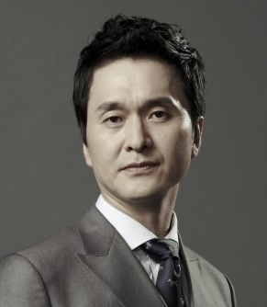
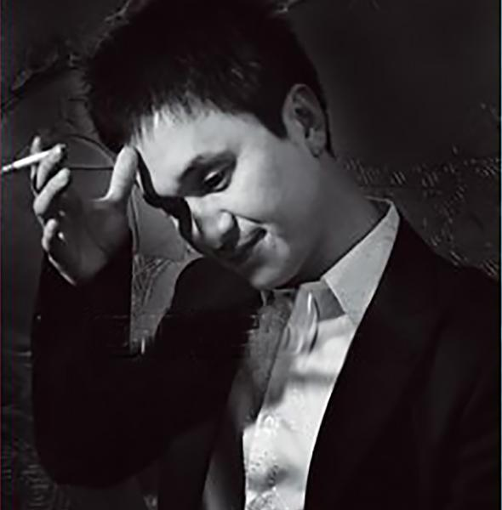
Gangster Victory
Jang, Hyun-sung (장현성) Korea’s Emmy Award-winning TV and Film Star has shown sincere interest to play Gangster Victory (극정파). 100+ leading credits
Gangster Victory (Pil-seung Pah) - Beneath the genius criminal is a truly bi-polar being just aching to get off his meds. His nemesis, Gangster Tiger, is an obsession. He sees and wants to use music to influence a generation. Jack and Kelly can help him.
Top Movies & Series
Rebound (2023) - basketball team coach
Kill Me Now (2022) – Starring as Min Seok
Money Heist: Korea | (Netflix / 2022)
Under the Queens Umbrella | (Netflix / 2022) - Minister of War
The Advocate: A Missing Body | (2015) - CEO Moon Ji-Hoon
Awards:
Best Couple Award ("Doctor Prisoner") - 2019 KBS Drama Awards - 2019
Best Actor ("Doctors") - 2016 (9th) Korea Drama Awards - 2016
Special Actor (medium-length drama) ("Heard It Through the Grapevine") - 2015 SBS Drama Awards - 2015
Special Actor ("Goddess of Marriage") - 2013 SBS Drama Awards - 2013

Slide 9
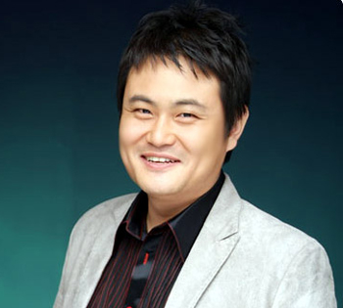
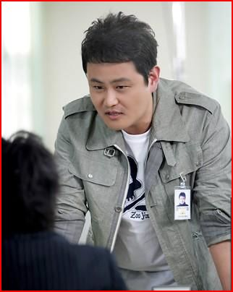
Gangster Polarity
Kim, Jin-Su (김진수) TV and Film Star has shown sincere interest to play Gangster Polarity (극성파).
60+ leading credits
Gangster Plarity (Kuk-seung Pah) – Bi-polar and mean. What else is there to say? He’s unpredictable. Stay out of his way because he always gets what he wants one way or another.
Top Movies & Series
Rebound (2023) – Vice Principal
The Eldest | Madi (JTBC / 2013-2014)
Can We Get Married? | (JTBC / 2012-2013)
Sin of a Family | (2011)
Be My Guest | Jukireo Kapnida (2011) - P.D. Oh (uncle)
Smile Again | Useora Donghaeya (KBS / 2010-2011) - Bang Ki-Nam
Loving You a Thousand Times | (SBS / 2009-2010) - P.D. Bong
Love and Obsession | Jang-hwa Hong-ryeon (KBS2 / 2009) - Maeng Hyung-Kyu

Slide 10
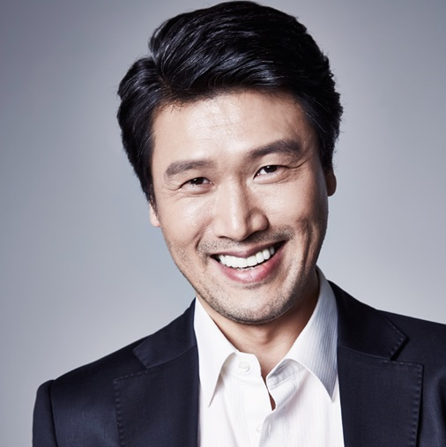
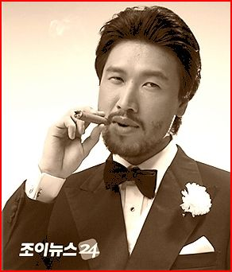
Detective Park
Sung Ki-Yoon (성기윤 ) TV, Stage, and Film Star has shown sincere interest to play Detective Park.
50+ leading credits
Detective Park – A kind and ambitious but somewhat naïve cop following Detective Chong around to help be a voice of reason and purity.
Top Movies & Series
Crash Course in Romance | (tvN / 2023) - Bang Dae-Geun
Reborn Rich | Chaeboljib Maknaeadeul (JTBC / 2022) Extraordinary Attorney Woo | 이상한 변호사 우영우 (Netflix 2022)
Insider (JTBC / 2022) - CEO Cha Seok-Hong (ep.10-11)
Love All Play | Neoege Ganeun Sokdo 493km (KBS2 / 2022)
Youth of May | Owolui Chungchoon (KBS2 / 2021) More Than Friends | Kyungwooui Soo (JTBC / 2020) -
At Eighteen | Yeolyeodeolui Soongan (JTBC / 2019)
Designated Survivor: 60 Days | 60Il, Jijungsaengjonja (tvN / 2019) Beautiful World | Areumdawoon Sesang (JTBC / 2019)
Encounter | Namjachingoo (tvN / 2018-2019)
Suits (KBS2 / 2018) - Hong Jae-Deok

Slide 11
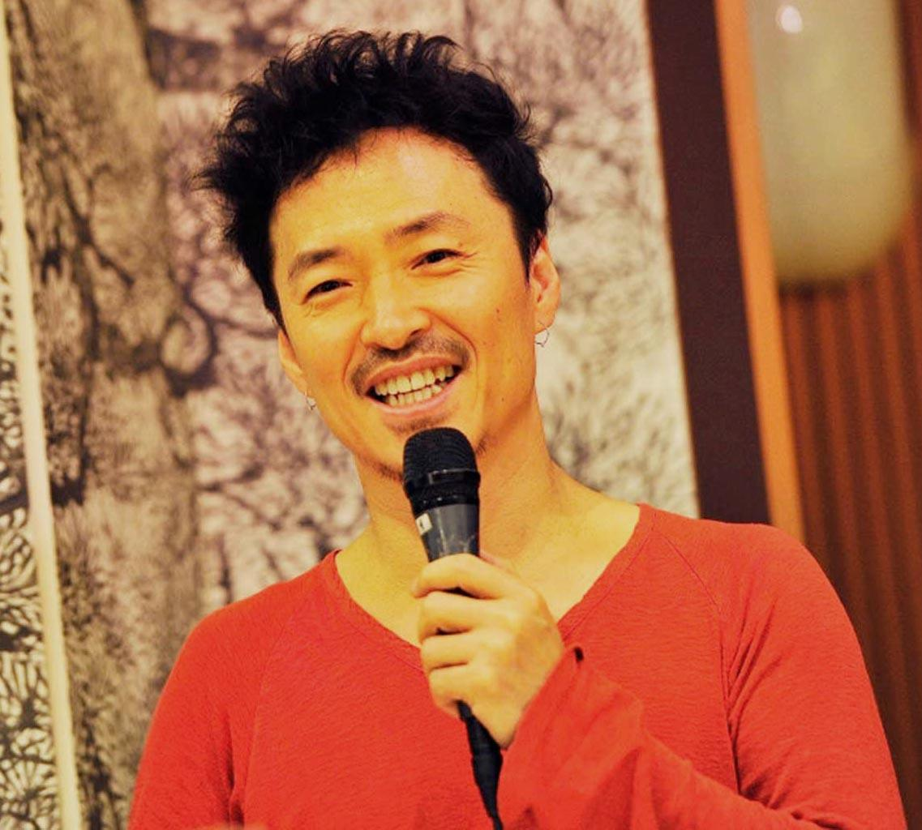
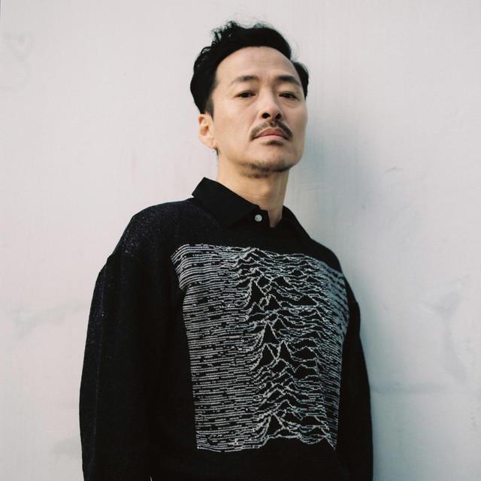
Producer Ha
Kang, San-ae (강산애) Korea’s prolific award-winning music star known as the Eric Clapton of Korea, has shown sincere interest to play Music Producer Ha.
Music Producer Ha - Seoul Music Media’s senior Music Producer. Backed by Gangsters, Ha is a cool, dark character, who will use his influence and power in the industry to control his interests.
Top Movies & Series
2016: "Night Song" - as a live singer
2016: "A Quiet Dream - as Fortune Teller
2016: "Beaten Black and Blue" - cameo
2013: "El Condor Pasa" - at music section
2011: "Battlefield Heroes - at music team
2011: "Pink" - as Bang Rang Gaek / wanderer
Studio albums
1992: Gangsan-e Vol. 0
1994: Me at the Puberty
1996: Ppittagi
1998: Salmon
2002: Kang Young-geul Vol.6
2008: Wet towel
1997: The Essence
1999: A morning, Remake Album
2001: Best Live

Slide 12
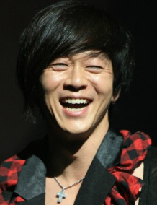
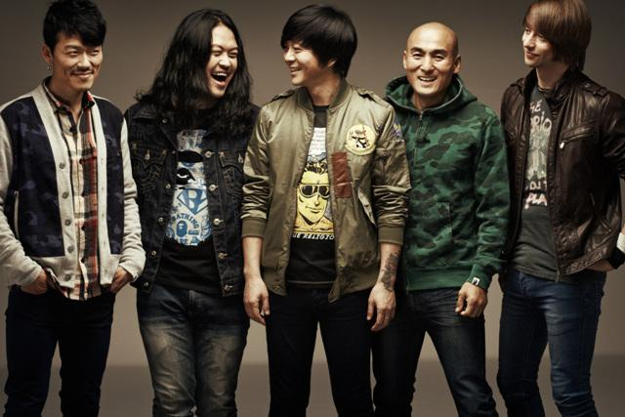
Yoon, Do-hyun
Yoon, Do-Hyun (윤도현) has expressed his sincere interest in working with us playing himself.
Rockstar - The very popular multiple award-winning high-energy real-life Rockstar, and the epitome of ‘cool’
1994 to present – Released 10 albums and one DVD
Multiple Year Winner of “Best Music Award” from KBS, MBC and SBS
2003 – First recipient of the WPMA (World Peace Music Award)
2002 – Performed during the Korea-Japan World Cup
“Best Musician” by selling over 2 million albums and playing more than 100 live concerts in a year - more than 500,000 audience
2005 – Toured Europe. The first ever European tour by a Korean artist.
2006 – sold out B.B. King’s Blues Club in New York City
2007 – Performed at the SXSW in Austin, Texas; Show Music Box Club in Seattle and the Opireum Theatre in L.A.
2009 Vans Warped Tour on the Kia Kevin Says Stage
2011 – original line-up in the internationally renowned “I Am A Singer” TV show
2012 Winner of “MNET Asian Music Awards (MAMA) – Producer’s Award”
2014 US Tour: Smashing Pumpkins, Dodger’s Stadium, The Whiskey in Hollywood.

Slide 13
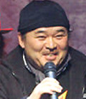
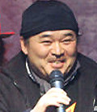
Uncle Lee
Uncle Lee - Kelly’s Uncle Lee is a bit of a mentor and parent to Kelly and Jack. Ready to help and scold with equal fervor. Lee, Gun-hee (이근희) Korea’s prolific award-winning comedic actor and B-Boyz Producer has shown sincere interest to play Uncle Lee.

Slide 14
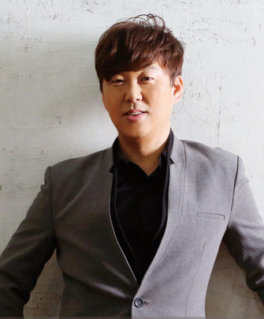
Byun, Jin-Seop
The very popular, highly acclaimed, and extremely talented singer, Byun Jin-sup has more #1 Hits than any other artist or group in Korea. He has a wonderful personality and has expressed his sincere interest in working with us playing any part, possibly as Kelly’s accountant Uncle – as well as her ailing and rarely seen father in a dual role. To be discussed with “my good friends, the producers.”

Slide 15
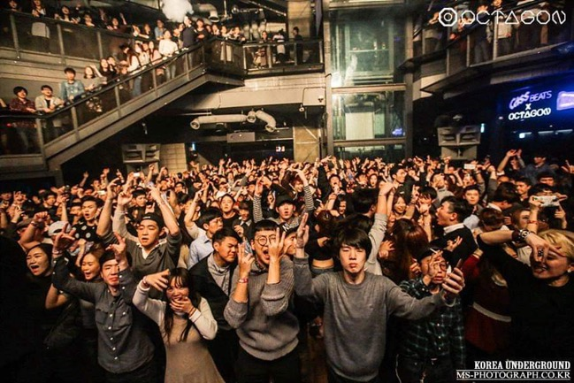



Setting: Seoul, Korea
1999
An incredibly vibrant city of 20+ million with its vibrant music and art scenes.
Where K-pop explodes in a world of music, money and gangsters…

Slide 16
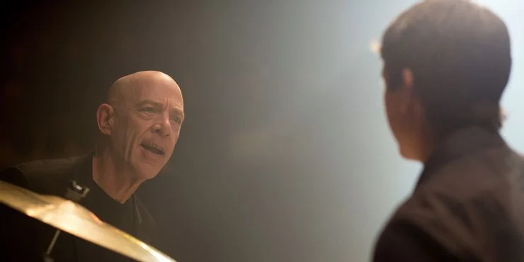
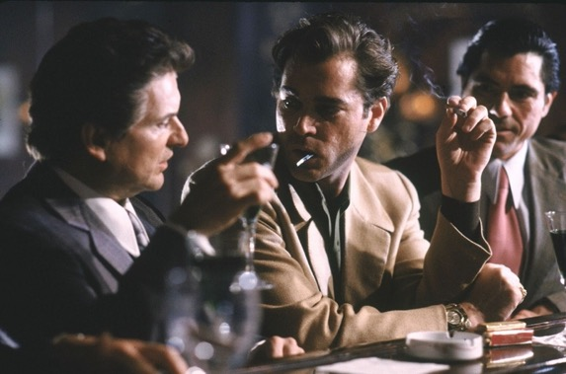
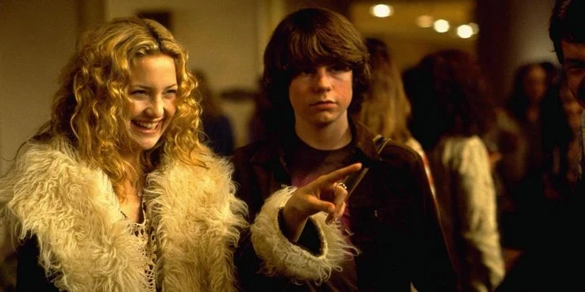
Setting the Scene:
”Whiplash” meets “Goodfellas” meets “Almost Famous”
TV: La Femme Nikita
Noir: LA Confidential
Thriller: ???

Slide 17


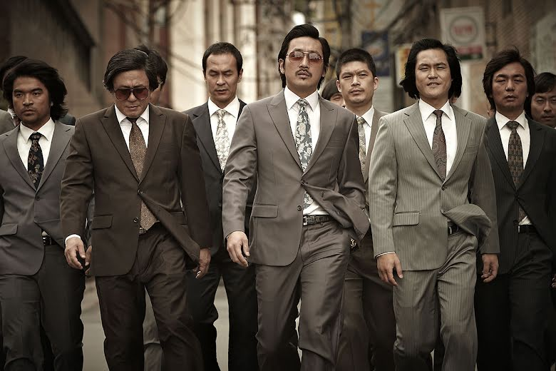
Setting the Scene: 1999
In 1999, the Music was jolted by the music lover’s shift from CD’s to the immediate gratification of the Digital download. The World of Napster
K-Pop was exploding in South Korea, creating a massive surge of Korean talent in music, dance & film.
Music=Money which means in Seoul that the music industry was rife with gangsters and gangs who sought its riches. As Jack was going to discover…

Slide 18
Setting the Seasons
SEASON 1 will focus on the "fish out of water" scenario. Jack moves from Los Angeles to Seoul and works with Kelly and her Father on building the label and navigating through cultural barriers. We meet the characters; the promoters, the talent, the brutal crime syndicate groups and we’ll introduce the world to the living city that is Seoul. Kelly and Jack learn to trust each other, working through language and cultural barriers. Note: Episode 1 Treatment Available
SEASON 2 will dive deeper into the individual power players and we’ll introduce new avenues of corruption, scandal within the music scene in Seoul. Music producer HA assumes a bigger role in finding acts. K-pop emerges as a power genre - and everyone wants a piece of the action. Gangster Tiger wants more control and entices Kelly and Jack to work with him to destroy the competition. A delicate dance for Kelly and Jack - they need to keep Tiger in check, but Tiger's influence with Kelly's father is strong. Kelly signs the top acts, including ROCK STAR, and Jack pushes the limits of promotion, granting free digital downloads of the first hit, which angers the industry leaders and those expecting tribute for their "help". Kelly and Jack grow closer, frustrating staff and talent and family. Detective Chong investigates the syndicates and cracks open a connection between Kelly and Tiger. Jack earns celebrity attention in the local gossip magazines and the US mags – which only angers the musical titans of his former company in the US.
SEASON 3 introduces the expanding crime syndicates control and the battles between Gangster Tiger and Gangster Victory. Kelly's father passes, leaving the label to Kelly and Tiger, which opens a wider door for Detective Chong tireless investigation. Romance evolves with Kelly and Jack, much to the disgust of Tiger. HA brings more acts, some cool, some dangerous – with some ‘moles’ from opposing crime syndicates. With fame, Jack loses control.

Slide 19
Setting the Scene:
Body & Seoul is a show driven by music, the personalities in the industry, and the insanity that follows it. Jack has to navigate the cultural faux pas that he stumbles into every day in this vibrant, exciting Asian country, and Kelly Lim works to keep him centered. He and Kelly go head-to-head with the politics of the music industry, the club owners, the artists, studios, and South Korean crime families. All for control of a growing music empire.
STORIES - “A”, “B” “C” AND “D”
Jack’s personal journey: Jack seeking redemption personally and professionally in a country where he is a complete fish out of water.
Jack and Kelly’s story: Jack meeting Kelly whose love for music is almost greater than his own innate desire to find talent and live through the emotional journey of both music and song. And the professional relationship they begin to build – with a tense dash of personal thrown into the mix.
Clash of the Gangsters: Gangster Tiger isn't happy with Jack interrupting his influence in the music business. He’s old school, like his father, and still wants his payola and kickbacks - but a new era is dawning with Jack and Kelly leading the charge. Gangster Victory wants a part of the emerging digital music business, and sees Jack's recent presence as a threat to his plans.
Always hounded by the police: Detective Chong is going to break the Gangster’s hold on music - but doing so legally. And Jack and Kelly are thorns in his side when he takes shortcuts.

Slide 20
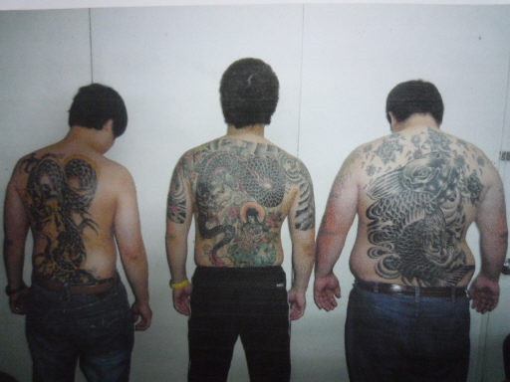
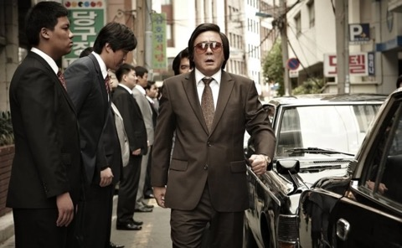
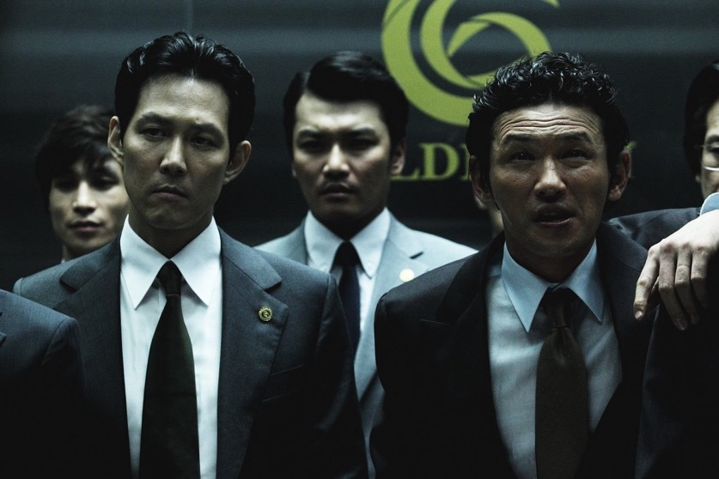

Setting the Scene: Gangsters
Learning from the Japanese “Yakuza” during their long and damaging occupation from 1910 to 1945, the Korean Mafia – called tha Kangpae – were extremely violent fighters and industrious in their criminal activity. And they had their hooks into the film and music industry.
One of our actors, Hwang, Jung-min,
Played against in this film.

Slide 21
Directing the Scene: Directors
Korean Television Directors have blossomed across the world stage with features and television. We believe that the extremely significant array of Korean talent assembled and excited to work with the producers and this story will allow us to get the finest Korean Director talent available today. Some of these might include:
Ahn Pan-seok – ”How Long I’ve Kissed”, “Secret Affair” “Heard it Through the Grapevine”
Jang Hang-jun– ”Break Out”, “Sign”
Kim Jin-min– ”Pride and Prejudice”, “Lawless Lawyer”
Lee Hyung-min– ”Bad Guy”, “Korean Peninsula”

Slide 22
Executive Producer and Showrunner Michael Mandaville has worked for 25 years as a Producer, bondable Line producer and UPM. His films include “Taken”, "Taken 2" and “Taken 3” with Luc Besson. He has an M.A. from at the University of Southern California. He has written novels, scripts, independent features, ebooks and web series. He is a member of the PGA and the DGA.

Slide 23
Executive Producer Dany Pape of SB Pictures is a Results-driven entertainment executive and 25+ year business owner with multiple years of experience in developing high quality, original projects through effective management, team collaboration and strong attention to detail. History of concurrently directing multiple projects while adhering to tight schedules and budgets. Offers an extensive background and advanced understanding of personnel acquisition, budget & finance, and multi-site management.

Slide 24
Executive Producer Robert Lennon started his career in the US Army Intel where he learned to speak Korean fluently and has cultivated considerable personal reach in Korean talent and production arenas. Robert has significant project management experience working on not only IT and marketing projects but also in live action films and animation “Rugrats,” “The Wild Thornberrys” and “Rocket Power.” Robert is a skilled marketing professional, currently working with several major Korean companies.
Executive Producer Hyunjung Lim is native to South Korea and an Honor Graduate from the prestigious Seoul Performing Arts Institute. She was the first rising star of her peers and an SBS TV Broadcasting Show Talent. She has performed as the leading lady in countless musicals such as “Cats,” “Jesus Christ Superstar,” “Joseph and the Amazing Dreamcoat”, “Westside Story,” and many other Korean productions. Ms. Lim’s years in Korean entertainment has cultivated many long-term and personal connections to talent and production in South Korea. We have this all-star award-winning cast thanks to Ms. Lim.

Slide 25






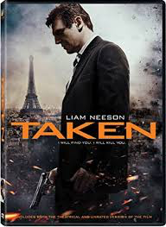

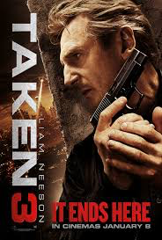
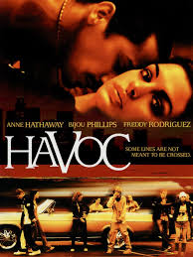
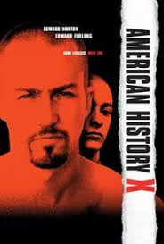



Michael Mandaville - Showrunner
Michael is a bondable Line Producer, working in physical production and combining his creative writing in novels and screenplays in FilmmakingWithACalculator.
WRITING –
USC M.A. Professional Writing
–14 Script Optioned or Hired-To-Write
-Novels & Non-Fiction Books on Amazon
-LINE PRODUCTION/UPM
Bondable Line Producer
–Feature Films: “Taken”, “Taken 2”, “Taken 3”, “American History X”, “Havoc”
-Ultra Low Budget Films & Series
Notes:
Now we have to talk about me because this is Hollywood and the film industry. And it’s always about “Me!”

Slide 26
Thank You!
Tai Truesdell
(310) 612-7996
tai@roguewaveent.com
Stephan Manpearl
(818) 486-6132
smanpearl@roadrunner.com

